Slide 1


Day 2

Slide 2
Objectives for today
Concept of Normality in our data
Alpha-diversity metrics to measure biodiversity
Beta-diversity and ordination plots

Slide 3
Let’s set-up Rstudio!
Don’t forget to set-up your working directory and load the required packages:
phyloseq;vegan;ggplot2;ggpubr
Let’s import our data:
seqtab.nochim=readRDS(“seqtab.nochim.RDS”)
taxa= read.table(file.choose(), header = TRUE, row.names = 1 , sep = ",")

Slide 4
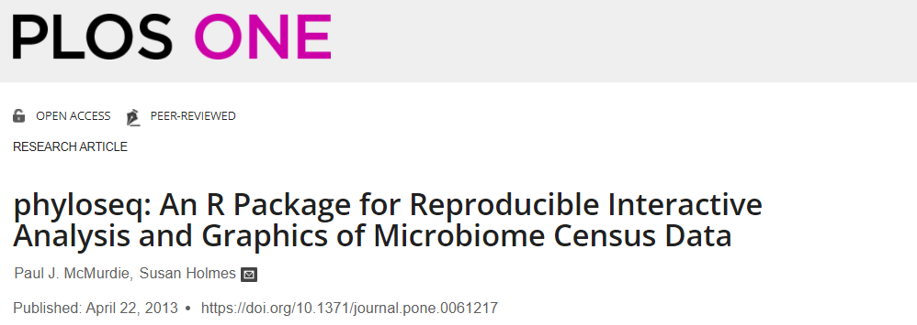
Who is phyloseq? What does it want from us?

Slide 5
The Phyloseq format
Metadata
samples
Sample x taxa matrix
Taxonomy
Sequences
taxa

Slide 6
Let’s assemble it!
Metadata
samples
Sample x taxa matrix
Taxonomy
Sequences
taxa
Notes:
Colnames(seq

Slide 7
How long are our reads?
Length of first read
nchar(colnames(seqtab.nochim)[1])
Let’s plot all of them!
hist(nchar(colnames(seqtab.nochim)))
Ok now let’s create a variable that contains all the sequences.
seqs=colnames(seqtab.nochim)
And convert the sequences into a format that phyloseq will recognize as sequences
seqs=Biostrings::DNAStringSet(seqs)

Slide 8
Let’s assemble it!
Metadata
samples
Sample x taxa matrix
Taxonomy
Sequences
taxa

Slide 9
The DIY section of the pipeline
A metadata file includes all the information you might want to add about your samples aside from taxonomy.
Can be categorical or numerical information:
Eg. Type of sample; temperature of the soil from which sample was taken; etc
In our case, the metadata table (in the github page) contains information about the location from which the samples were taken.

Slide 10
Lets re-create the metadata using Rstudio command line
meta=data.frame(Field_source=c("Peanut","Peanut","Peanut","Peanut","Peanut","Maize","Maize","Maize","Maize","Sunflower","Sunflower","Sunflower","Sunflower"))
row.names(meta)=row.names(seqtab.nochim)
Let’s check the table
meta

Slide 11
Let’s assemble it!
Metadata
samples
Sample x taxa matrix
Taxonomy
Sequences
taxa

Slide 12
Important! How do you want R to think about unclassified taxa?
taxa$Phylum[is.na(taxa$Phylum)]<-taxa$Kingdom[is.na(taxa$Phylum)]
taxa$Class[is.na(taxa$Class)]<-taxa$Phylum[is.na(taxa$Class)]
taxa$Order[is.na(taxa$Order)]<-taxa$Class[is.na(taxa$Order)]
taxa$Family[is.na(taxa$Family)]<-taxa$Order[is.na(taxa$Family)]
taxa$Genus[is.na(taxa$Genus)]<-taxa$Family[is.na(taxa$Genus)]
taxa[] <- lapply(taxa, as.factor)
taxa=as.matrix(taxa)

Slide 13
Let’s assemble it!
Metadata
samples
Sample x taxa matrix
Taxonomy
Sequences
taxa

Slide 14
Now we have to make all taxon names match
colnames(seqtab.nochim)=paste0("ASV",1:ncol(seqtab.nochim))
names(seqs)=colnames(seqtab.nochim)
row.names(taxa)=colnames(seqtab.nochim)
Sample x taxa matrix
Taxonomy
Sequences

Slide 15
Let’s put them together!
Tell phyloseq what your tables are:
asv_table_physeq = otu_table(seqtab.nochim, taxa_are_rows=FALSE)
taxonomy_physeq = tax_table(taxa)
metadata = sample_data(meta)
Put everything in one object:
physeq=phyloseq(asv_table_physeq, taxonomy_physeq, metadata, seqs)

Slide 16
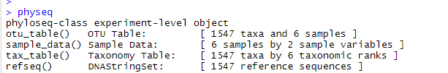
Behold your phyloseq object!
physeq

Slide 17
Handy phyloseq operations:
How many samples?
nsamples(physeq)
How many ASVs?
ntaxa(physeq)
How many observations/reads per sample?
sample_sums(physeq)
How many times is each ASV observed?
taxa_sums(physeq)

Slide 18
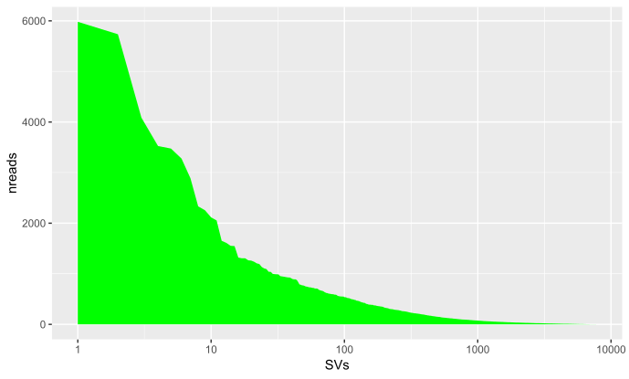
Let’s play a bit! Plot ASV read distribution
library(ggplot2)
reads_per_ASV=data.frame(nreads = sort(taxa_sums(physeq), TRUE), SVs = 1:ntaxa(physeq))
ggplot(data=reads_per_ASV, aes(x = SVs, y = nreads))+ geom_area(stat="identity“, fill="#69BE28")+scale_x_log10()
This is an example of non-normally distributed data
Common for compositional data
Remember where your plots are.

Slide 19
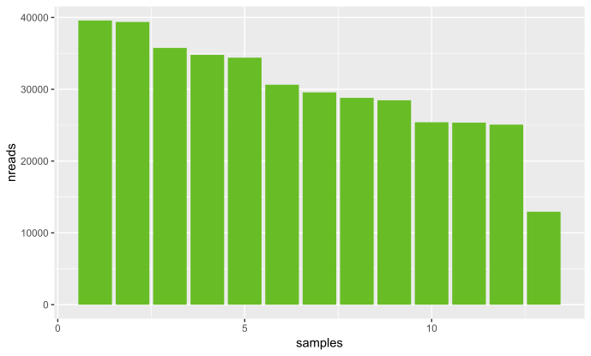
Let’s play a bit! Plot sample read distribution
reads_per_sample=data.frame(nreads = sort(sample_sums(physeq),TRUE), samples = 1:nsamples(physeq), type = "Samples")
ggplot(data=reads_per_sample, aes(x = samples, y = nreads))+ geom_bar(stat="identity“, fill="#69BE28”)

Slide 20
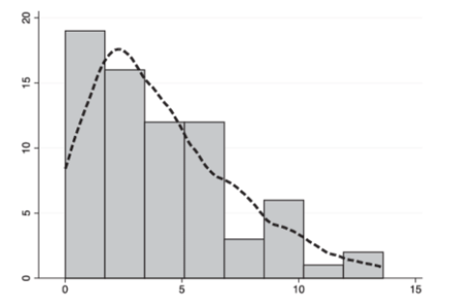
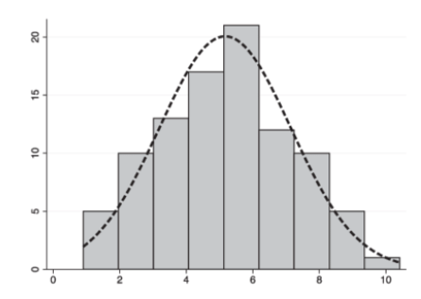
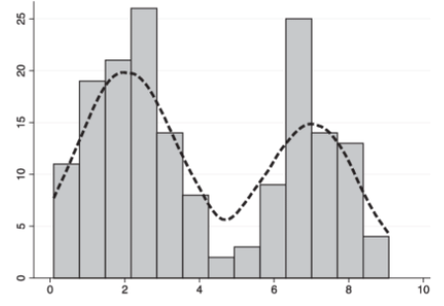
Normal Vs Non-normal distributions
Non-normal positively skewed
Normal distribution
Binomial
We will touch of this later!

Slide 21
Normalization of ASV counts across sample set
Sample A
9 apples
Sample B
3 apples
Not Comparable
Uneven datasets are not comparable due to differences in population sizes.
Normalization/standardization is used to allow the data to be comparable.
There are several methods for Normalization/standardization: eg. Rarefaction; Relative abundance; Total Sum Normalization (TSM).
https://besjournals.onlinelibrary.wiley.com/doi/full/10.1111/2041-210X.13115

Slide 22
Rarefaction
Sample A
9 apples
Sample B
3 apples
Sample A
3 apples
Sample B
3 apples
Rarefaction transforms the counts for each sample so that the total corresponds to the total counts of the sample with the lowest counts
Rarecurve = rarecurve(seqtab.nochim), step=50, cex=0.5)

Slide 23
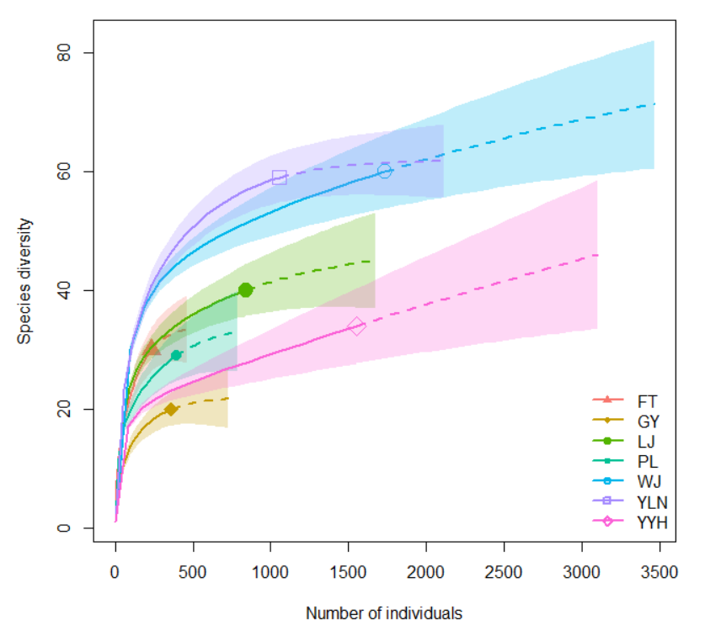
https://www.davidzeleny.net
Notes:
In addition, this framework can account for species abundance by changing the parameter q, which can be any non-negative number (e.g., 0, 0.99, 2). As q increases, the diversity values become more sensitive to common species. When q= 0, species abundance is ignored; q= 1, all species are weighted by their abundance equally (i.e., Shannon’s diversity for taxonomic diversity); q= 2, common species get more weight
than rare species (i.e., inverse of Simpson diversity for taxonomic diversity).

Slide 24
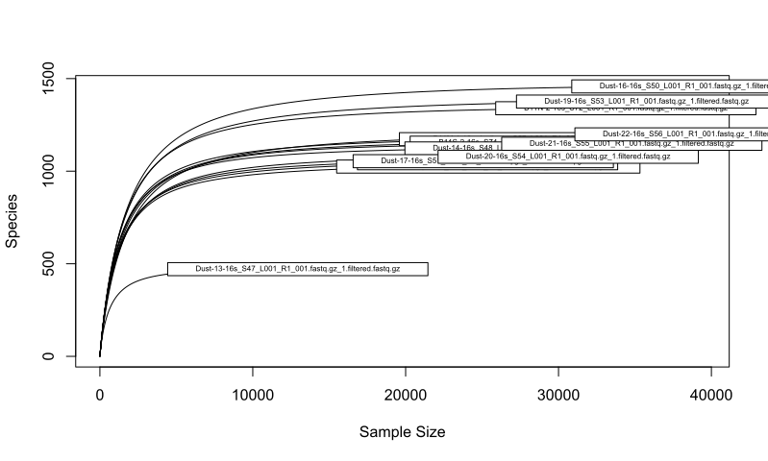
What does our data look like?

Slide 25
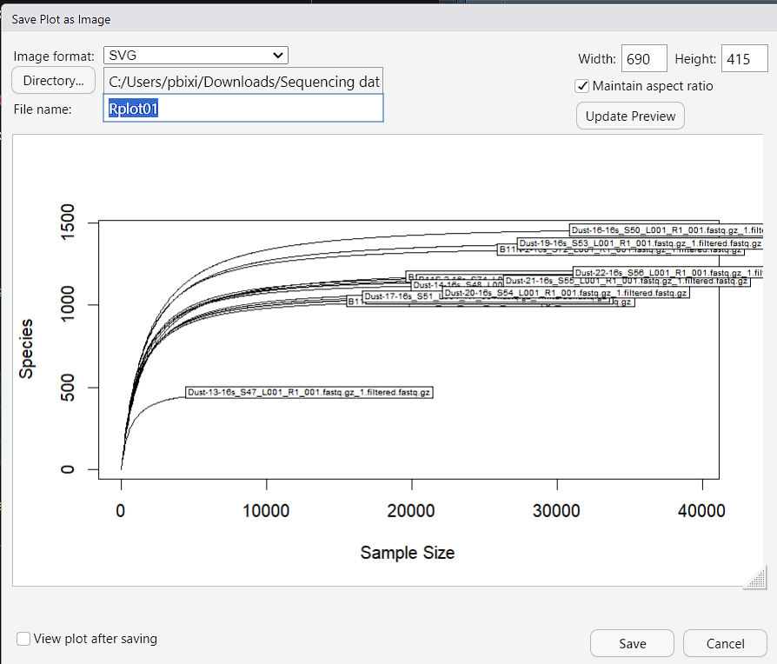
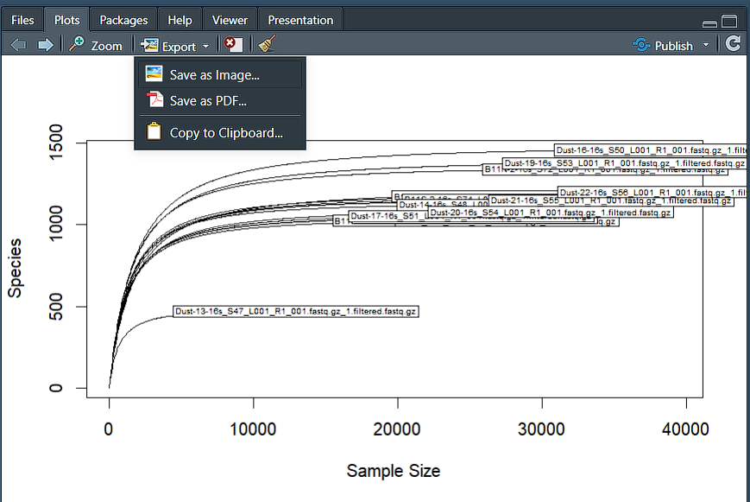
Exporting plots

Slide 26
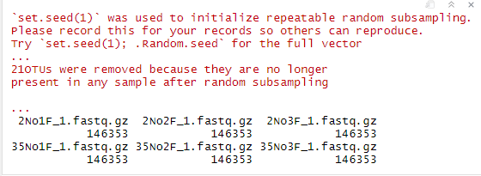
Rarefy your samples !
rarefied=rarefy_even_depth(physeq, sample.size = min(sample_sums(physeq)), rngseed=1)
sample_sums(rarefied)
Rarefaction will result in loss of low-abundance ASVs = loss of diversity

Slide 27
Trimming the data
How many empty ASVs do you have?
sum(taxa_sums(rarefied) == 0)
Remove these empty ASVs!
rarefied = prune_taxa(taxa_sums(rarefied) > 0, rarefied)

Slide 28
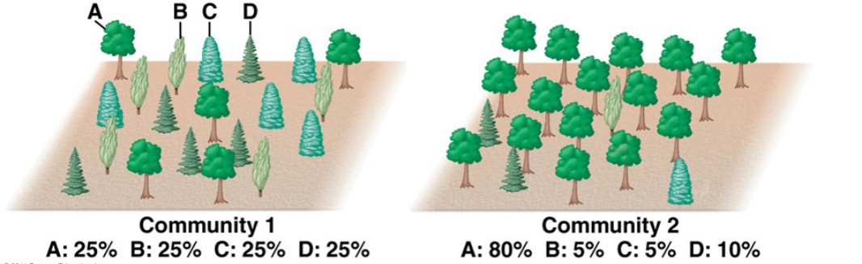
Measuring Biodiversity
In Microbial ecology, biodiversity of a system is estimated by looking at the alpha-diversity, i.e. the within sample diversity.
This is a combination of how many ASVs are in a sample (richness) and how evenly distributed they are. Higher richness and more even distribution = more diversity.
https://rstudio-pubs-static.s3.amazonaws.com/343284_cbadd2f3b7cd42f3aced2d3f42dc6d33.html

Slide 29
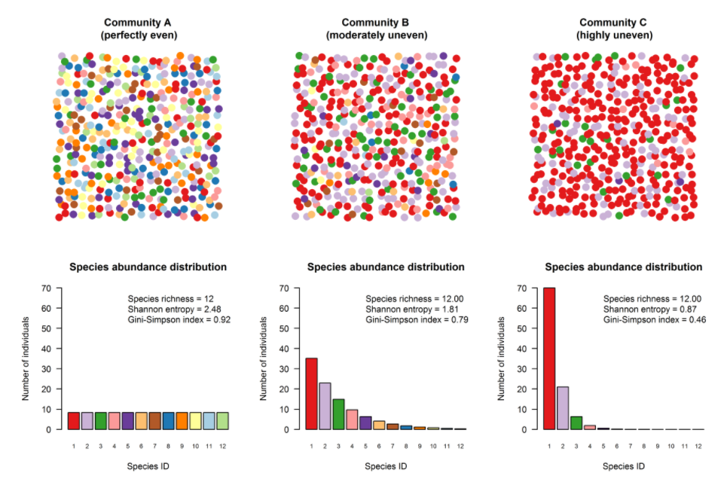
Looking further into evenness
https://www.davidzeleny.net/anadat-r/doku.php/en:div-ind#hill_numbers

Slide 30
Species richness (S): Easy! Intuitive!
Species richness = number of ASVs in your sample
This is not an absolute number! ASVs in your table do not represent the “real” number of species in a community.
Richness=specnumber(rarefied@otu_table@.Data)
https://www.davidzeleny.net/anadat-r/doku.php/en:div-ind#hill_numbers

Slide 31
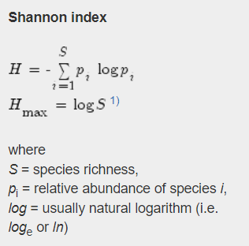
Shannon’s Entropy
Most widely used biodiversity index
The uncertainty with which we can predict of which species will be one randomly selected individual in the community
The maximum value of H index (H_{max}) for community occurs at complete evenness
Units: bits
https://www.davidzeleny.net/anadat-r/doku.php/en:div-ind#hill_numbers
Notes:
the uncertainty with which we can predict of which species will be one randomly selected individual in the community. If community contains only one species, the uncertainty is zero, since we are sure that randomly chosen individual will belong to that one only species. The more species the community contains, the more uncertainty increases; in a diverse community, we are unlikely to guess of which species will be the randomly chosen individual. However, if community has many species, but only one (or few) prevails (many individuals of one or few species), uncertainty will not be so high, since we have high probability that randomly selected individual will be the most abundant species. This is why Shannon index increases with richness and evenness, and it puts more weight on the richness than on evenness.

Slide 32
Bonus! Pielou’s J (or Shannon’s evenness)
Pielou= Shannon/log(Richness)
1 in a completely even community, 0 in a completely uneven community

Slide 33
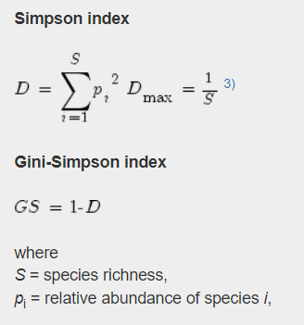
Simpson
The simpson index represents the probability that two randomly selected individuals will be of the same species. Since this probability decreases with increasing species richness, the Simpson index also decreases with richness.
If richness>10 (that’s us!), PIE is mostly influenced by changes in evenness
Units: probability
I prefer inverse-Simpson, in which higher numbers mean higher evenness
https://www.davidzeleny.net/anadat-r/doku.php/en:div-ind#hill_numbers

Slide 34
There are problems
We are measuring diversity in bits (?) and probabilities (?) when the natural unit of diversity is species
Effective number of species: the number of species in equivalent community (i.e. the one which has the same value of diversity index as the community in question) composed of equally-abundant species. In a fully even community, ENS=S. Otherwise, ENS<S
https://www.davidzeleny.net/anadat-r/doku.php/en:div-ind#hill_numbers

Slide 35
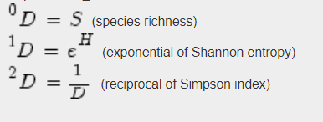
Hill numbers
Proposed by Mark Hill
Unify diversity indices along a gradient of q, which quantifies how much the measure discounts rare species when calculating diversity.
Hill q0= Richness
Hill q1= Shannon diversity, or the ENS derived from Shannon’s entropy
Hill q2= Simpson diversity, or the ENS derived from Simpson’s concentration
As q increases, rare species are less important.
https://www.davidzeleny.net/anadat-r/doku.php/en:div-ind#hill_numbers

Slide 36
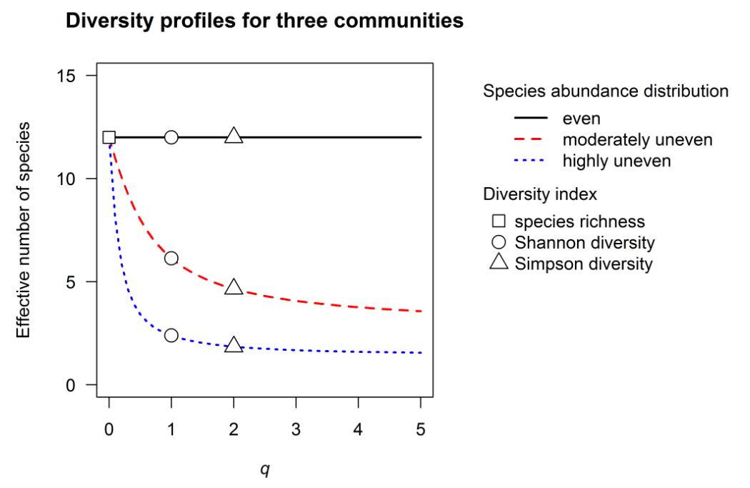
Alpha diversity along a continuum
https://www.davidzeleny.net/anadat-r/doku.php/en:div-ind#hill_numbers

Slide 37
Calculate everything at once!
Phyloseq allows you to calculate a bunch of alpha-diversity metrics all at once:
richnesses=estimate_richness(rarefied)
View(richnesses)

Slide 38
OK let’s add this to the metadata!
Add richness to your phyloseq object (recommended)
rarefied@sam_data$Observed=richnesses$Observed
Add metadata to your richness dataframe
alpha_table = cbind(as.data.frame(rarefied@sam_data), richnesses)

Slide 39
Quiz!
How can we plot this data?

Slide 40
Plotting alpha-diversity
Boxplots are a common way to represent alpha-diversity:
observed_compare = ggplot (alpha_table, aes( x= Field_source, y = Observed, color = Field_source)) + geom_boxplot()
Lets improve it a little bit:
observed_compare_v2 = observed_compare + geom_point (aes(color = depth), size = 3, position = position_jitterdodge())+theme_classic()

Slide 41
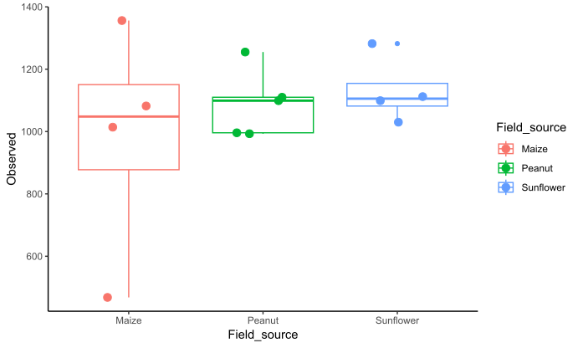

Slide 42
Is the alpha-diversity between field sources signifantly different?
First we need to check for normality of our data! Different tests assume different distributions
Normal distribution: t-test (two groups) ; ANOVA (more than two)
Non-Normal distribution: Mann-Whitney-Wilcoxon (two groups); Kruskal-Wallis (more than two)
hist(alpha_table$Observed) #plot an histogram of your data. Does it look normal?
shapiro.test(alpha_table$Observed)#use the shapiro test to check for normality
Null-hypothesis for the shapiro test: data is normally distributed.

Slide 43
What test do we use?
How many groups we have?
Is our data normally distributed?
If it is: anova_test = aov(Observed ~ Field_source, data = alpha_table)
summary(anova_test)
If it is not: kruskal.test(Observed ~ Field_source, data= alpha_table)
Are the groups different? What is the p-value?

Slide 44
Results from Kruskal-Wallis test
Kruskal-Wallis rank sum test
data: Observed by Field_source
Kruskal-Wallis chi-squared = 1.0455, df = 2, p-value = 0.5929

Slide 45
Displaying significance tests
You can use the function stat_compare_means from the ggpubr package to display comparisons
Install and load ggpubr
observed_compare_v3 = observed_compare_v2 + stat_compare_means(method = “kruskal.test”)
You can add brackets to show comparisons between pairs of groups:
my_comparisons <- list( c(“Sunflower", “Maize"), c(“Sunflower", “Peanut"), c(“Maize", “Peanut") )
observed_compare_v3 = observed_compare_v2 + stat_compare_means(comparisons = my_comparisons,method = "wilcox.test")

Slide 46
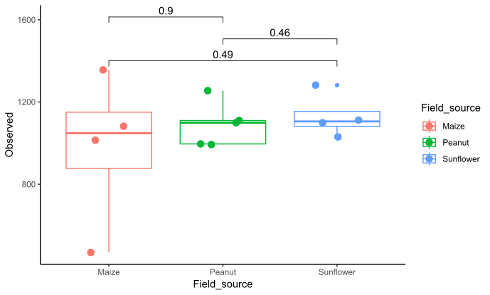

Slide 47
Let’s talk beta-diversity
Beta-diversity is between-sample diversity.
Is measured as dissimilarity between samples based on joint abundances/presences and/or absences.
Several metrics: Bray-Curtis; Jaccard, Unifrac.
Displayed in ordination plots.
https://sites.google.com/site/mb3gustame/reference/dissimilarity
Notes:
Multivariate species composition data can be imagined as samples located in multidimensional hyperspace, where each dimension (axis) is represented by an abundance of one species

Slide 48
Bray-Curtis and Jaccard metrics
Both are widely used distance-based measurements of dissimilarity in community composition between samples.
Jaccard index is based on the presence/absence of species: more sensitive to “founding” effects.
Bray-Curtis index is based on species abundance: more sensitive to temporal changes in the community.

Slide 49
Ordination
Ordination reduces the number of dimensions in a dataset, to return new, information-rich dimensions
If the individual variables are completely independent of each other (that’s us!) ordination is not likely to find some reasonable reduction of the multidimensional space.
Ordinations can also measure how much the explanatory variables explain these species gradients

Slide 50
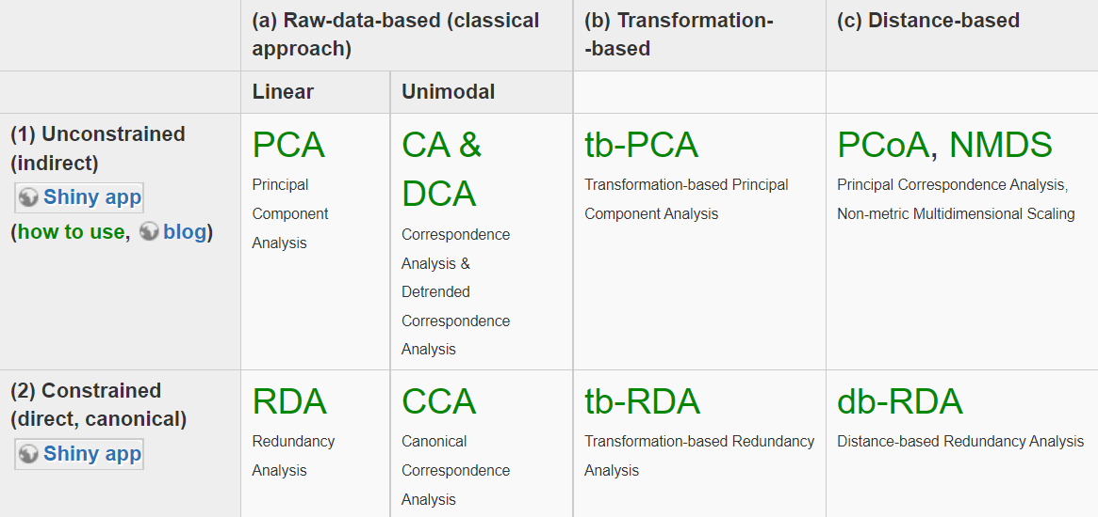
Types of ordinations
https://www.davidzeleny.net/anadat-r/doku.php/en:ordination
Notes:
PCoA returns a set of orthogonal axes whose importance is measured by eigenvalues. This means that calculating PCoA on Euclidean distances among samples yields the same results as PCA calculated on the covariance matrix of the same dataset (if scaling 1 is used), and PCoA on Chi-square distances similar results to CA. he PCoA may produce axes with negative eigenvalues which cannot be plotted. Solution to this is to either convert the non-metric dissimilarity index to metric one (e.g. Bray-Curtis dissimilarity is not metric, but after square-root transformation becomes metric

Slide 51
Let’s do some basic ordinations!
My favorite part of phyloseq
Really a pain to transfer R ordinations into ggplot
But actually just eye candy
Two parts:
Ordinate
Plot

Slide 52
Plotting a PCoA
Rarefied_distance = phyloseq::distance(rarefied, method = "bray")
View(as.matrix(Rarefied_distance))
What beta-diversity metric are we calculating?
Ordinate:
rarefied_ordination <- ordinate(physeq = rarefied, method = "PCoA", distance = Rarefied_distance)
Plot the ordination:
plot_ordination(rarefied, rarefied_ordination, color="Field_source")

Slide 53
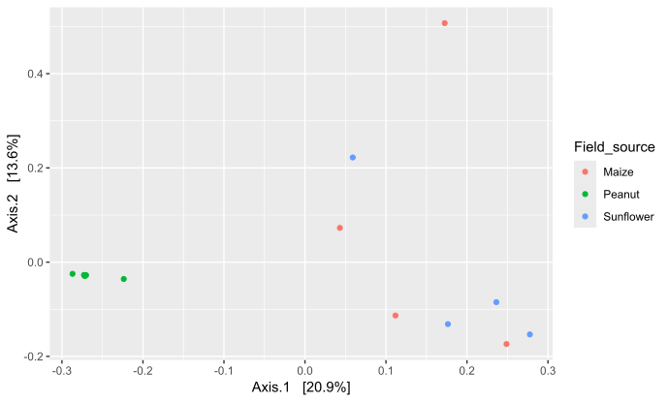
Very hard to see

Slide 54
Let’s improve things
Replot with larger point size and remove that grey background:
Ordination_plot = plot_ordination(rarefied, rarefied_ordination, color="Field_source") + geom_point(size = 3) + theme_bw()
Let also add some ellipses:
Ordination_plot_2 = Ordination_plot + stat_ellipse(geom = "polygon", aes(fill = Field_source), alpha = 0.25)

Slide 55
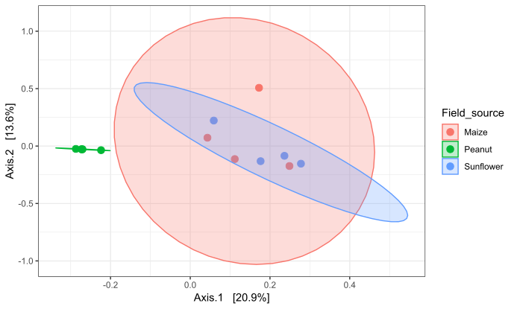
Much better!

Slide 56
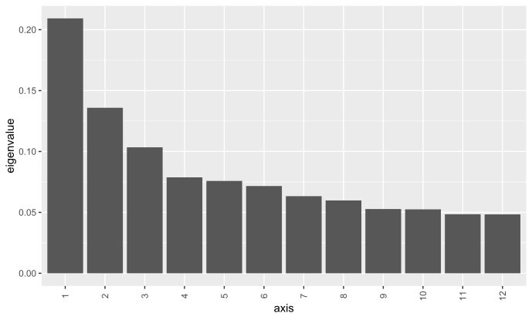
How well do the first two axes represent the data?
plot_scree(rarefied.o)
Notes:
The eigenvalues associated with each axis indicate the relative proportion of total variability within the distance matrix that is represented in that axis.

Slide 57
Let’s plot an NMDS instead
Just tries to represent the dissimilarity matrix as best it can in two 2D by… trying
Rank-based: less power, more adaptable
If the final stress value is >0.2, do not use NMDS
Points that are closer are more similar
Rarefied.nmdso= ordinate(rarefied, method=“NMDS”, distance=“bray”)
plot_ordination(rarefied, Rarefied.nmdso, color=“Time")
Did it work?

Slide 58
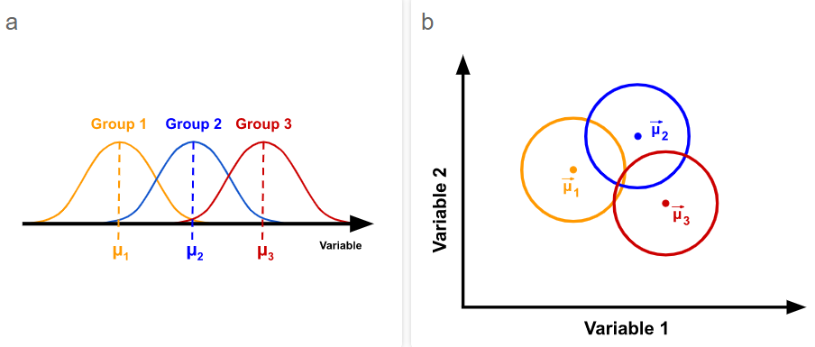
But, “are the groups different”? Permutational multivariate analysis of variance (PERMANOVA)
?adonis()
https://mb3is.megx.net/gustame/hypothesis-tests/manova

Slide 59
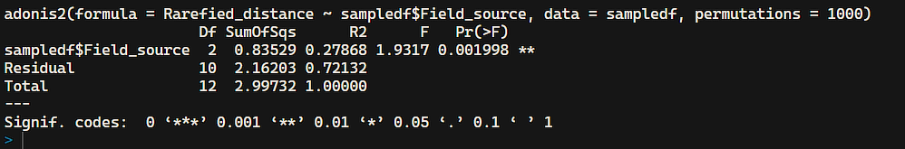
Test the hypothesis that the microbiomes are different depending on the source
Convert sample data into a data frame:
sampledf = data.frame(sample_data(rarefied))
Run the PERMANOVA test:
adonis2(Rarefied_distance ~ sampledf$Field_source, data = sampledf, permutations = 1000)

Slide 60
A note on permutation and p-values
You are creating a distribution from your data. With low sample numbers, your distribution is still very small, and your discriminatory power stays low (your p-values stay high)
For permutation-based stats, a good rule of thumb is 5 replicates.
Adonis is sensitive to the order you input your explanatory variables in!

Slide 61
Are microbiomes more variable in maize and sunflower dust?
We assess intra-group variation using betadispersion
Betadispersion measures the homogeneity of intra-group dispersions (variation) between different groups.
Null hypothesis: groups have similar intra-group dispersions
Bdisp=betadisper(bray.dist, rarefied@sam_data$Time)
permutest(mod, pairwise = TRUE, permutations = 1000)
Plot(Bdisp)

Slide 62
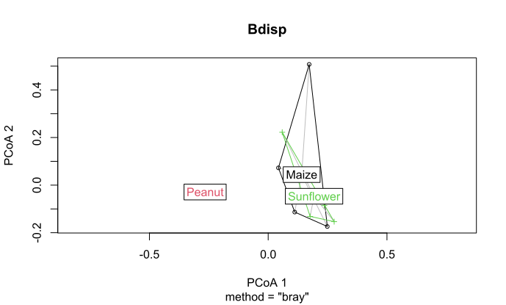

Slide 63
A note on significant adonis and betadisper
If our dispersions are different, the differences between the groups can be due to the differences in dispersions

Slide 64
Q & A

